Slide 1
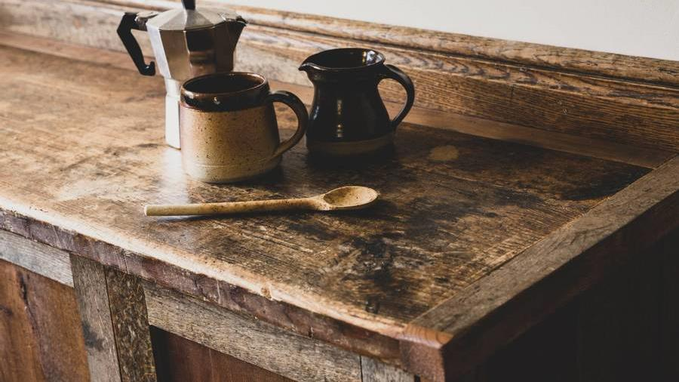
Bright Coffee Shop Sales Analysis
Sebolelo Mary Moshe

Slide 2


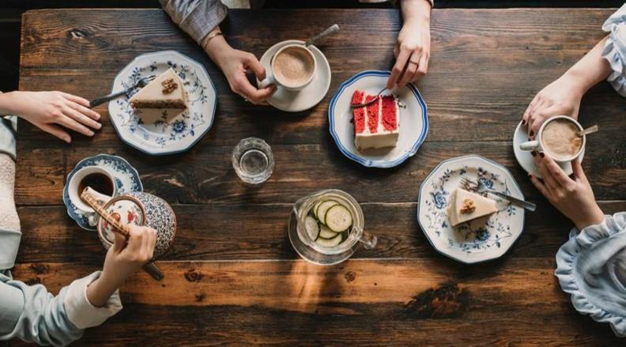
Agenda
Which store generates more revenue for the company
Which products generate the most revenue
What time of day the store performs best
Sales trends across products and time intervals
Recommendations for improving sales performance

Slide 3

Introduction
Business Insights for a New CEO using Historical Transactional Data from Bright Coffee Shop.

Slide 4
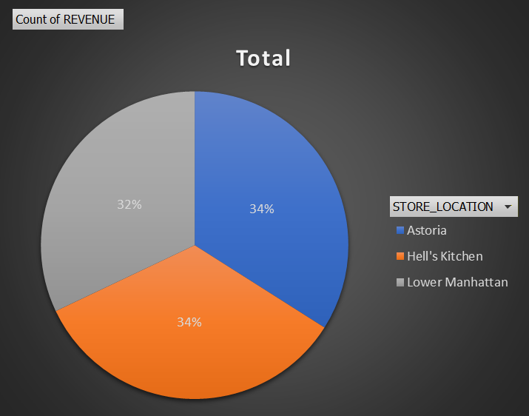
Sales Trends Across 3 Stores Locations
From the above data stats the most revenue of Bright Coffee Shop comes from Astoria shop with sales of 22 912 which is 34% of the overall sales.

Slide 5
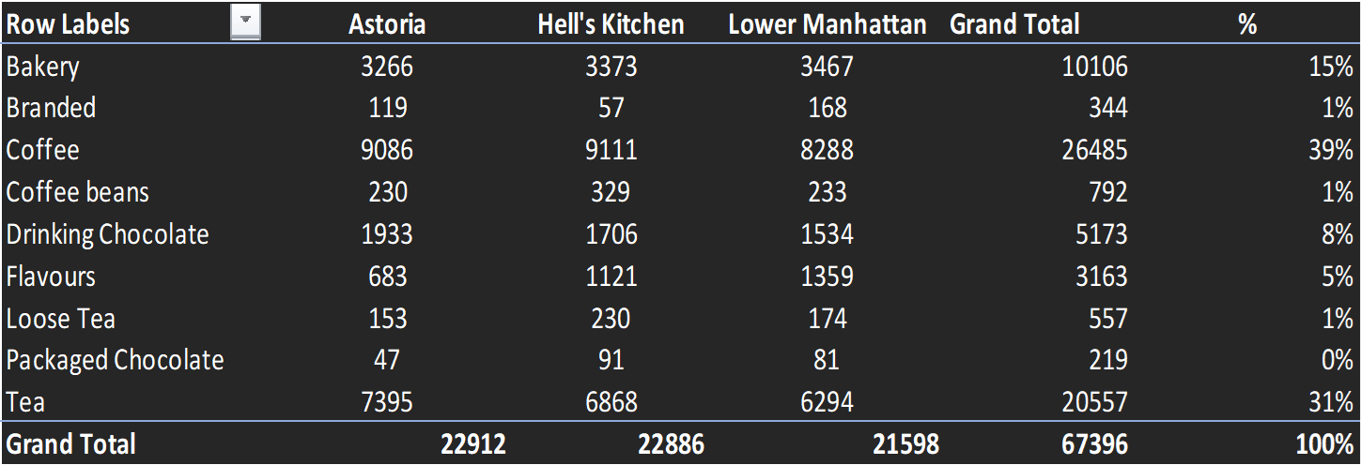
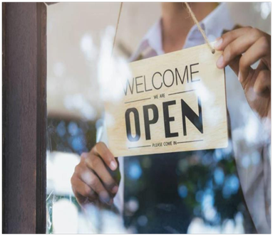
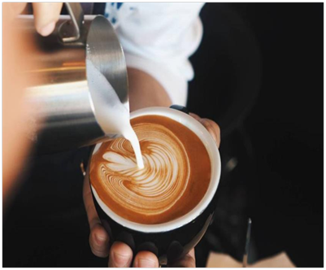
The Products That Generate The Most Revenue

Slide 6
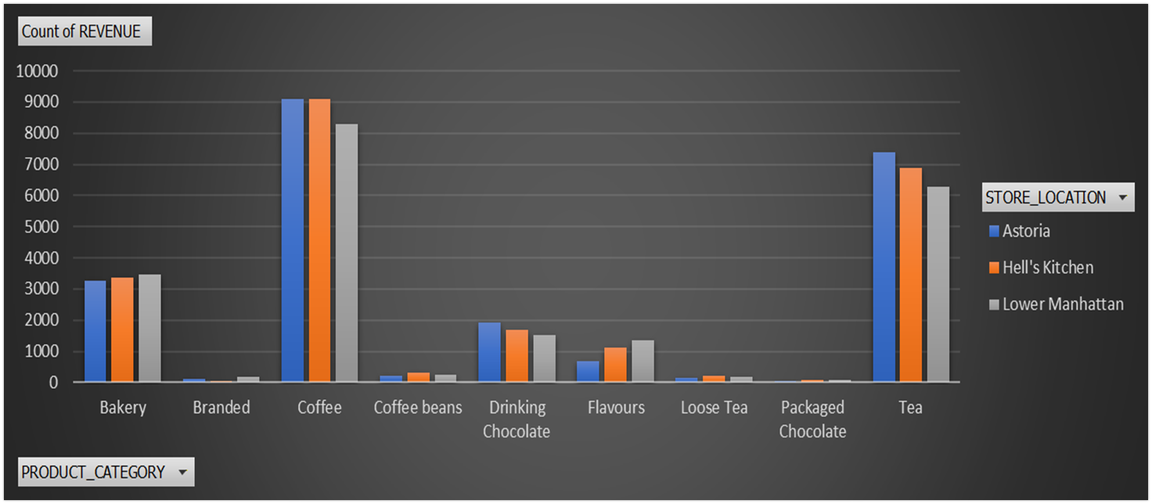
The Products That Generate The Most Revenue
The top 3 products selling fast include:
  Coffee – 39%
  Tea – 31%
  Bakery – 15%

Slide 7
The Time Of Day The Company Performs Best
Most of the sales happen during the morning between 06:00 And 12:00 at 55% sales percentage. During this time slot Bright Coffee shop is making a lot of revenue on a daily bases.
Sales starts dropping slowly in the afternoon to 24% between 12:00 And 16:00.
7

Slide 8
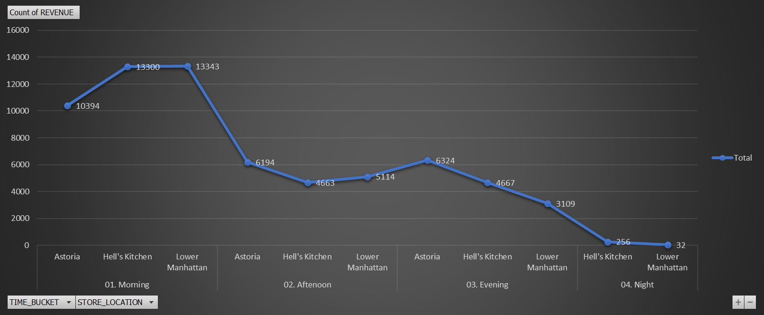
The Time Of Day The Company Performs Best
The above graph show the 3 stores locations sales revenue increment from morning and the gradual dropping from afternoon through to evening and night time slots
8

Slide 9
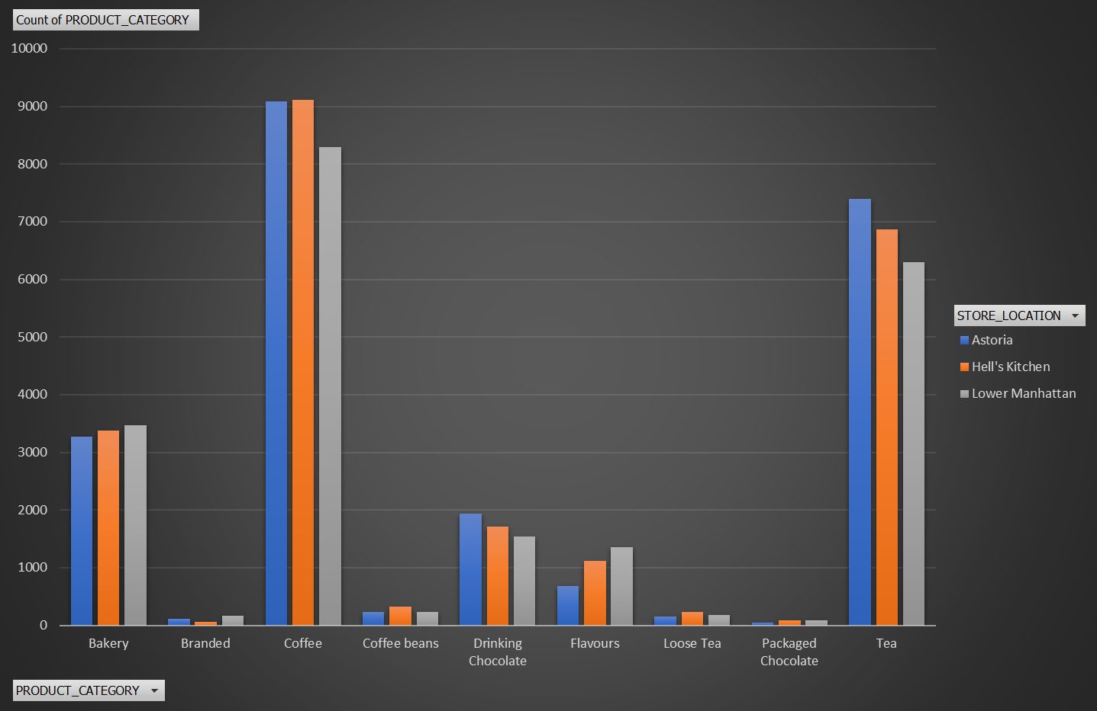
Sales Trends Across Products And Time Intervals

Slide 10
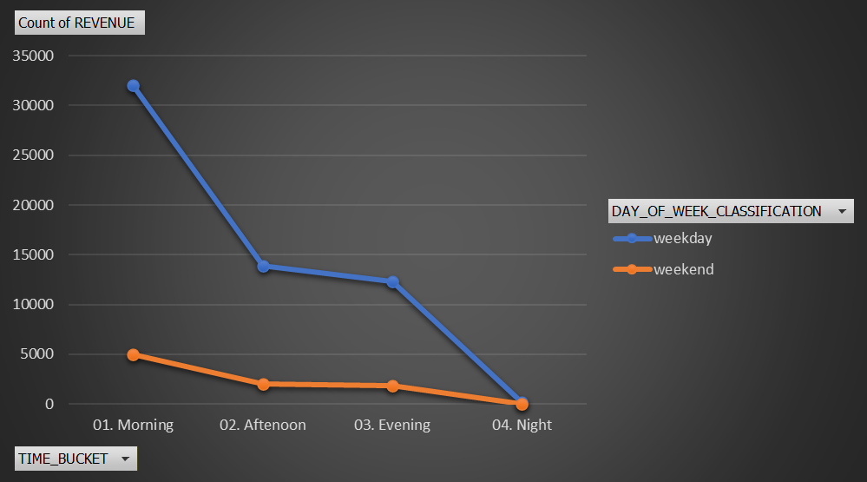
Weekdays Vs Weekend Sales
The above graph shows that revenue for the company is mostly generated on weekdays in comparison to the weekend.
10

Slide 11

SUMMARY
Sales revenue duration stats for all 3 stores includes:
  May 2023 at 32 269 – (48%)
  Jun 2023 at 35 127 – (52%)
Revenue is mostly attained during week days and in the morning hours at:
  Morning at 37 037 – (55% )
  Afternoon at 15 971 – (24%)
  Evening at 14 100 – (21%)
  Night at 0% - (0%)
The 3 Main Sold Products Brining Sales Revenue include:
  Coffee at 26 485 - (39%)
  Tea at 20 557 - (31%)
  Bakery at 10 106 - (15%)
Revenue Sales for all 3 stores locations include:
  Astoria at 22 912 - (34%)
  Hell’s Kitchen at 22 886 – (34%)
  Lower Manhattan at 21 598 – (32%)

Slide 12
RECOMMENDATIONS
Due to revenue sales being high in the morning Bright Coffee shop cannot be opened after 06:00 as the target market may be potentially lost if there is any form of delay.
We need to introduce ice coffee and tea options in the afternoon as these cold products can potentially draw our customers into buying during the afternoons and evening time slots. Our revenue will gradually improve for both time buckets sales.
Bright Coffee shop cannot operate without the 3 main sold products (i.e. Coffee, Tea, Bakery) as these generate the most revenue into the company (i.e. These stock products must be readily available across all stores)
Products sales for lower Manhattan will need reviewing as the sales percentage is the lowest of the 3 store location of the company.
Astoria store has great sales however at night there is 0% sales revenue which needs detailed review on how it can be improved.
We need to review if we still need to have stores opened during night time bucket as there is not revenue generated however we have operational costs that still impact the company.

Slide 13
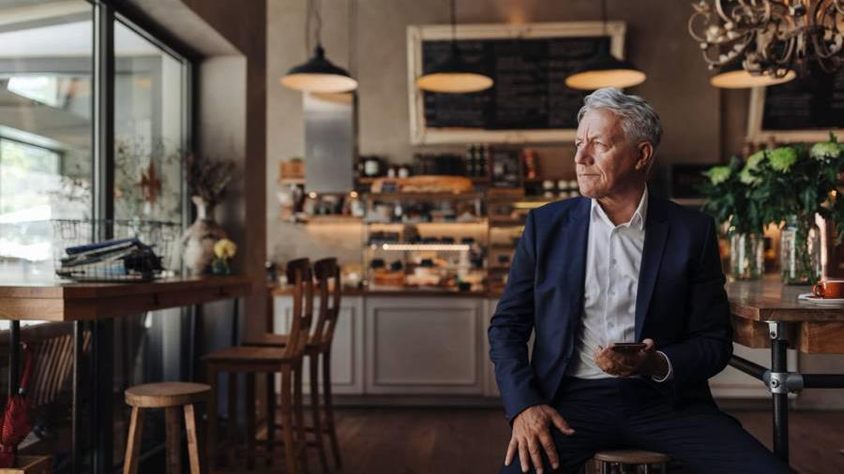
Thank you
Sebolelo Mary Moshe
MSebolelo@gmail.com

